Slide 1
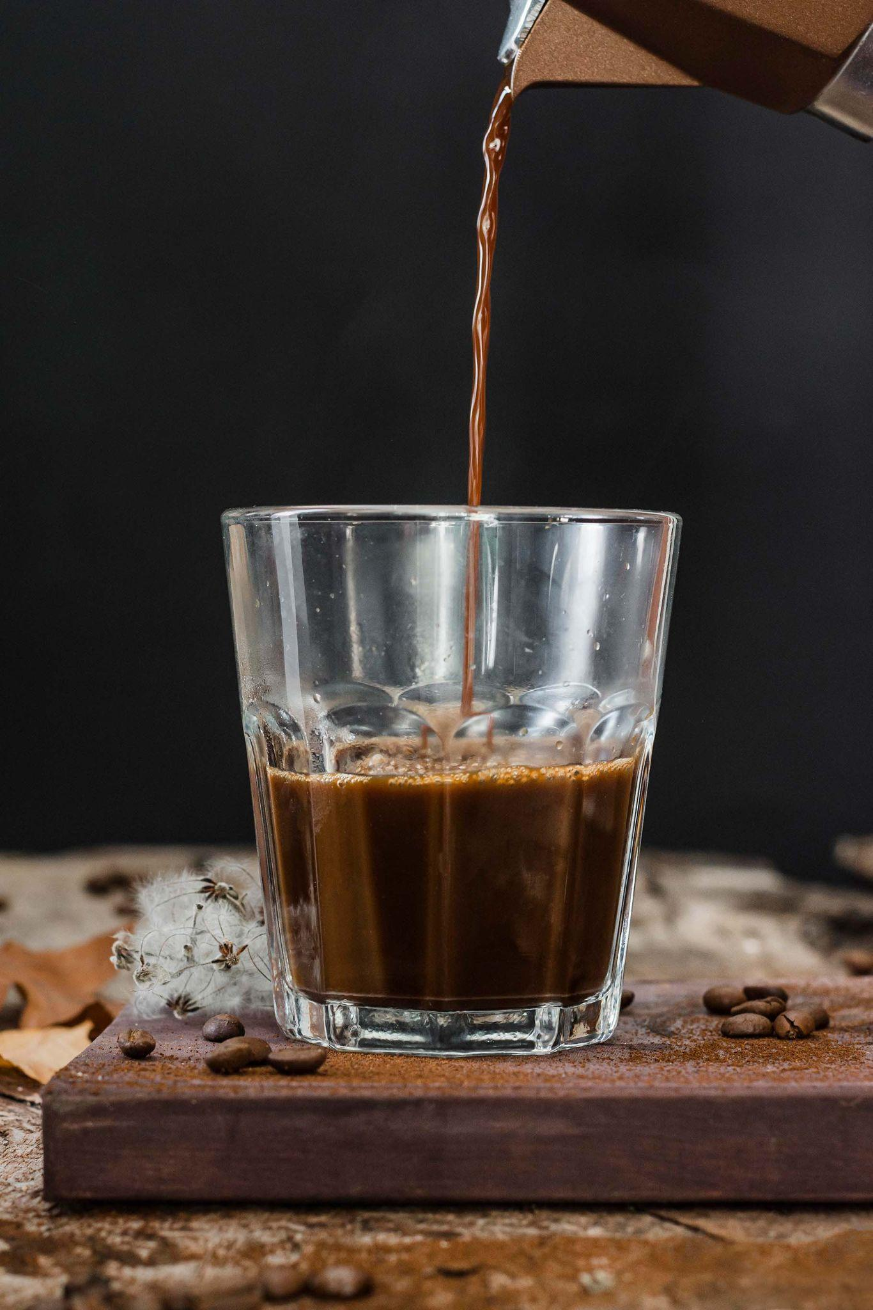
COFFEE QUALITY
Presented By: Manuella Kwawu
Last Updated: May 24, 2024
Notes:
Hi, I am Manuella Kwawu and I will be taking you through my work this week trying to analysis features that influence coffee quality

Slide 2
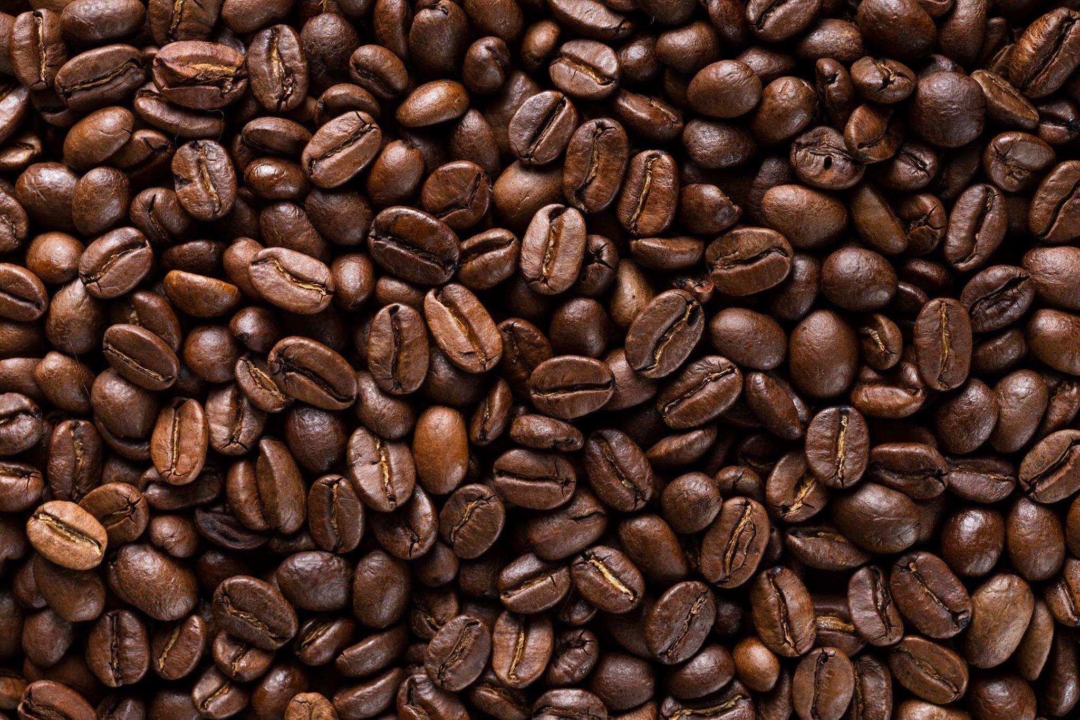
TABLE OF CONTENTS
01
02
03
04
Motivation & Objectives
Data Overview
Data Analysis
Takeaways & Recommendations
Notes:
My presentation will cover 4 main grounds- motivation for the project, data used, analysis & key findings from the data and some recommendations

Slide 3
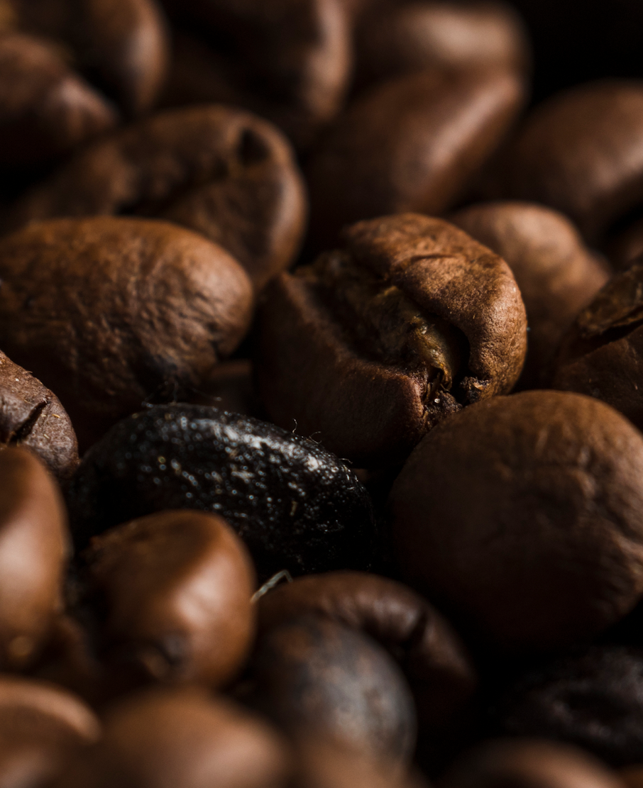
Motivation & Objectives
CO
FF
EE

Slide 4
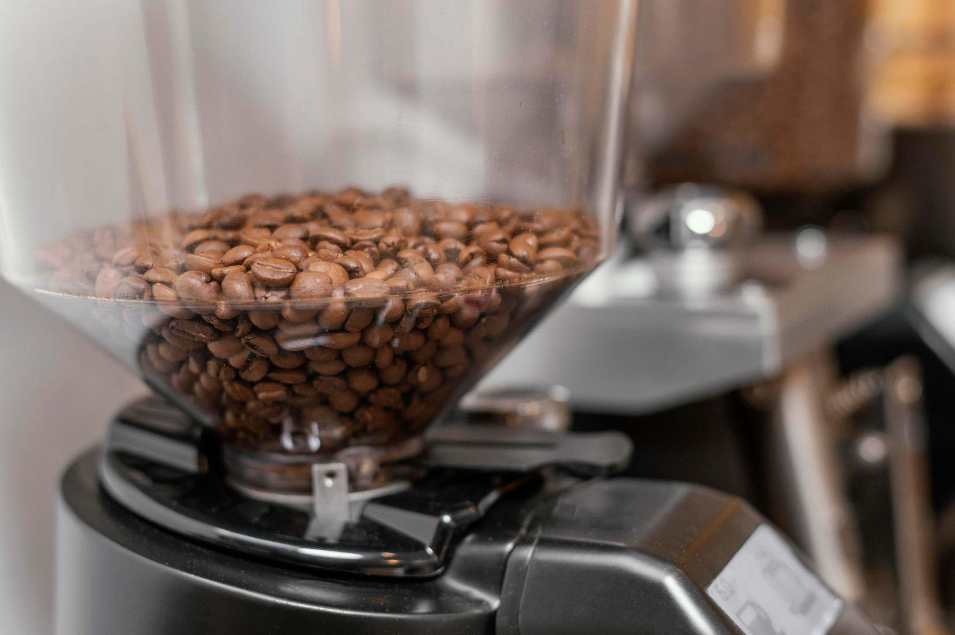
Motivation
For a company like Java’s Crypt that specializes in providing quality third-wave brews to workaholic techies everywhere, it is important to know what professionals tasters value in coffee.
A step towards gaining national recognition in the coffee brewing industry

Slide 5

Objectives
provide insights into characteristics of coffee that are prioritized and valued by professional raters.
provide data-driven recommendations for sourcing and processing coffee so as to enable Java’s Crypt gain national recognition.

Slide 6
Data Overview
CO
FF
EE

Slide 7
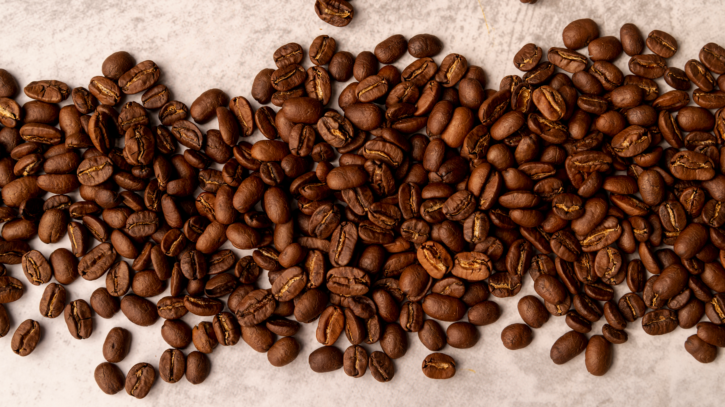
Data Overview
Information on coffee cuppings provides a more trustworthy source for ratings of the coffee beans analysed by professionals.
Data used shows professional ratings on different characteristics of coffee beans harvested from 2009 to 2018 across different countries.

Slide 8
Data Overview
Data provided can be categorized as follows:
10 quality measures including aroma, aftertaste, flavor, and balance.
Each scored out of 10.
Total cup points out of 100
Bean Metadata: species, color, processing method
Farm Metadata: certification body, country_of_origin, altitude, farm owner, etc
Data Source: Coffee Quality Database
Notes:
Standarding: correcting spelling mistakes, removing insignificant columns on coffee descriptions
recoding data: replacing some information with 0s and 1s
removing outliers in quakers and category defects

Slide 9
Some Background Knowledge
Coffee Cupping: professional practice of observing the taste and aroma of brewed coffee
Coffee Species: Arabica(~60%) and Robusta(~40%) produced globally
Aroma: the smell of the coffee when infused with hot water
Flavor: represents the coffee's principal character- the combined impression of all the gustatory (taste bud) sensations and retro-nasal aromas that go from the mouth to nose
Aftertaste: the length of positive flavor (taste and aroma) qualities emanating from the back of the palate and remaining after the coffee is expectorated or swallowed
Uniformity: consistency of flavor of the different cups of the sample tasted
Clean Cup: the lack of interfering negative impressions from first ingestion to final aftertaste, a "transparency" of cup.
Quakers: pale, underripe coffee beans that are only visible after roasting
Source: database.coffeeinstitute.org

Slide 10
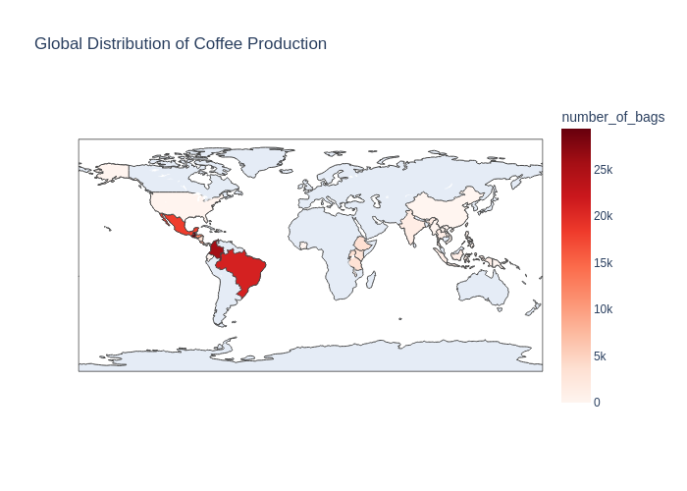
Top Global Coffee Producers:
Guatemala
Colombia
Brazil
Mexico
Honduras
Mexico
Guatemala
Colombia
Brazil
Honduras
Click here to view interactive map

Slide 11
Green raw coffee beans are most common
Color of coffee bean | Number of Bags Tested | Average Altitude of Region | Avg Total Cup Points
Blue-Green | 1300 | 9500 | 83.0
Bluish-Green | 1400 | 12400 | 82.8
Green | 2000 | 120400 | 82.1
Numbers rounded to the nearest 100
Notes:
Take away: 1. insignificant correlation between mean_altitude and any of the other variables

Slide 12
Green raw coffee beans are most common
Color of coffee beans doesn’t affect total cup points
Color of coffee bean | Number of Bags Tested | Average Altitude of Region | Avg Total Cup Points
Blue-Green | 1300 | 9500 | 83.0
Bluish-Green | 1400 | 12400 | 82.8
Green | 2000 | 120400 | 82.1
Numbers rounded to the nearest 100
Notes:
Take away: 1. insignificant correlation between mean_altitude and any of the other variables

Slide 13
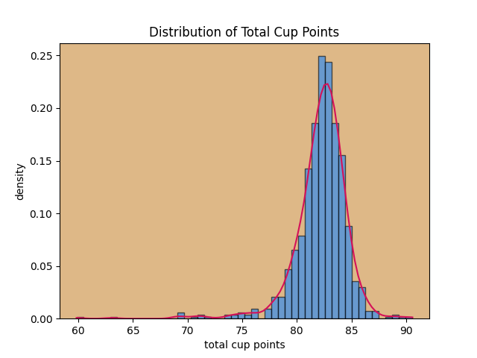
Total Points Distributions
~83 points
80th percentile
Notes:
Transition into the 3 areas of analysis - correlations, performance of certification bodies/in country partners and influence of processing methods in the overall coffee quality

Slide 14
Analysis -
Correlations
CO
FF
EE

Slide 15
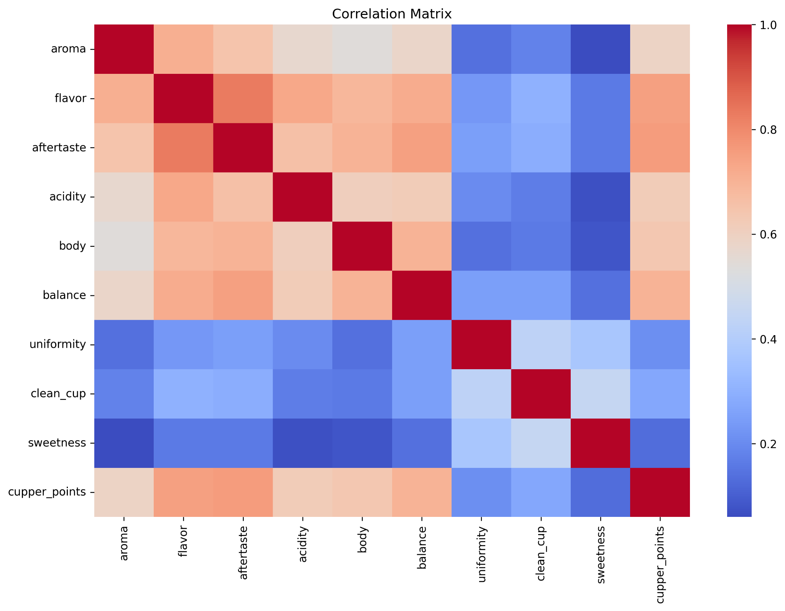
Correlation among quality measures
Points awarded for Flavor, Aftertaste Acidity, Body and Balance have strong correlation among themselves

Slide 16
Correlation among quality measures
Points awarded for Uniformity, Sweetness and Clean cup have very weak correlation with all other quality measures

Slide 17
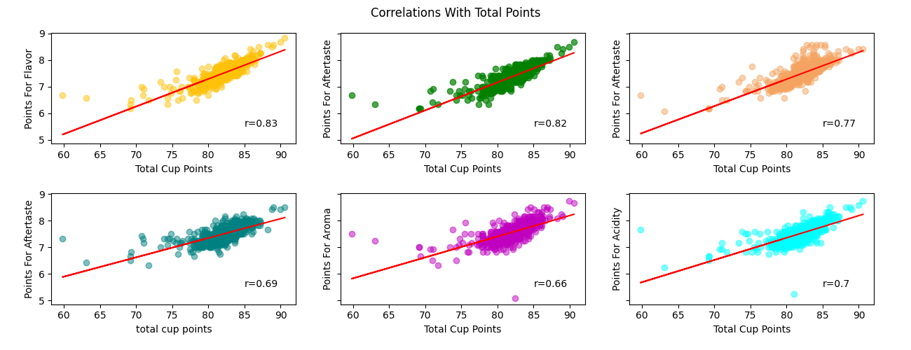
Quality measures with strong correlation to total cup points
Flavor
Aftertaste
Aroma
Acidity
Balance
Clean cup
Notes:
Shared y-values

Slide 18
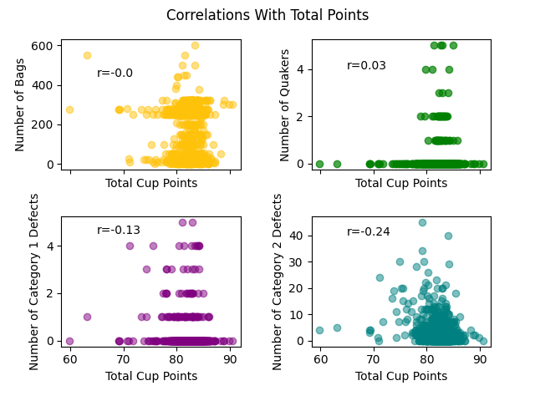
Features with negligible effects on the total cup points
Number of bags tested
Number of quakers in bag
Number of beans with category 1 defects in bag
Number of beans with category 2 defects in bag

Slide 19
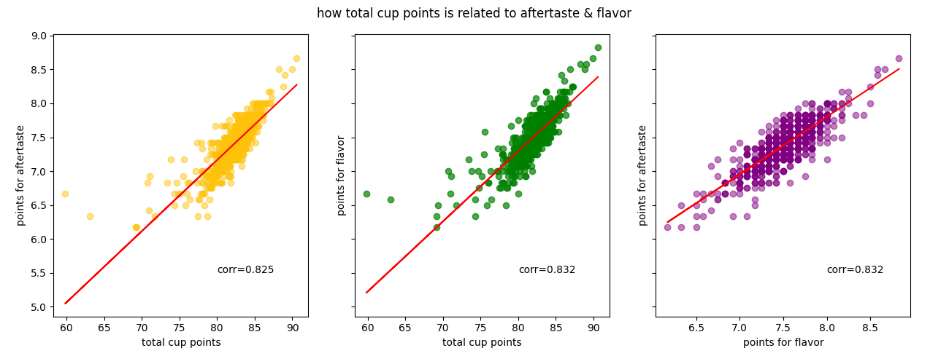
Highly significant quality measures
Notes:
Take away:
very strong positive correlations:
total_cup_points and flavor & total_cup_points and aftertaste
strong positive correlations:
total_cup_points and aroma & total_cup_points and acidity & total_cup_points and body & total_cup_points and balance
total_cup_points and clean_cup & total_cup_points and cupper_points
Some measures/ factors that do not significantly impact total score: moisture, quakers, category 1 & 2 defects

Slide 20
Analysis -
Certification bodies
CO
FF
EE

Slide 21
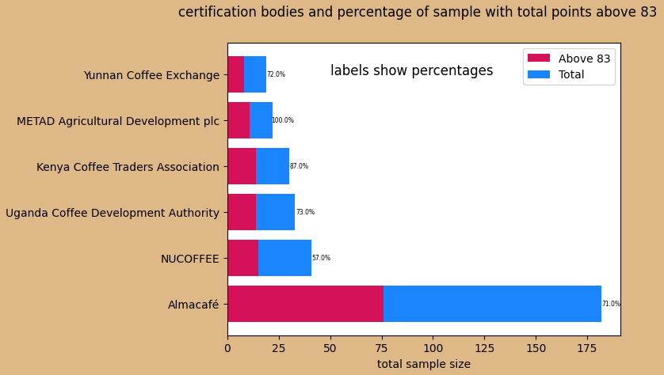
Certification bodies
Showing only certification bodies with percentages above 50%

Slide 22
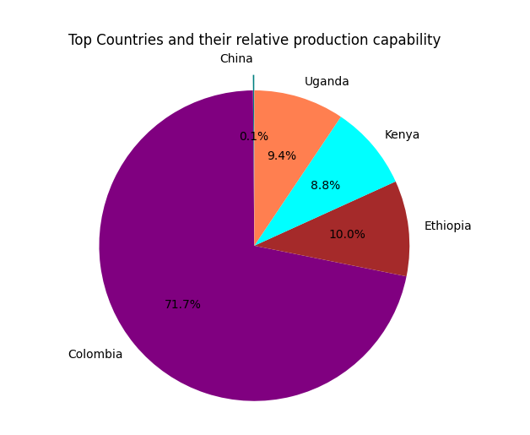
Top 5 Certification Bodies
Certification Body | Countries of origin
METAD Agricultural Development PLC | Ethiopia
Kenya Coffee Traders Association | Kenya
Uganda Coffee Development Authority | Uganda
Yunnan Coffee Exchange | China
Almacafé | Colombia
Notes:
Take away: 1. insignificant correlation between mean_altitude and any of the other variables

Slide 23
Analysis -
Processing Methods
CO
FF
EE

Slide 24
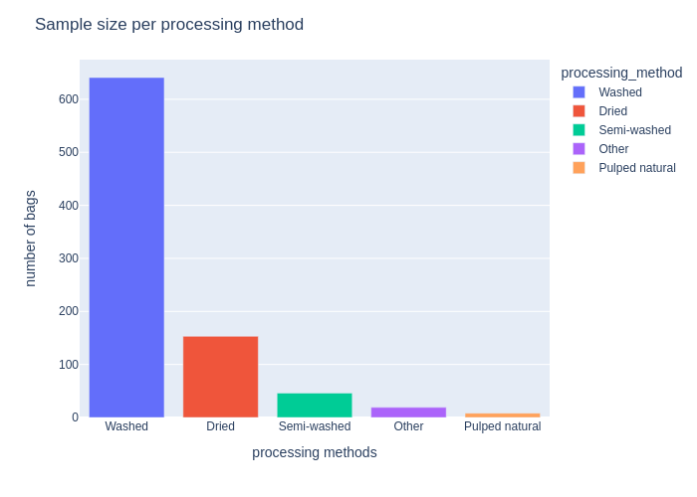
Most coffee beans are processed by washing

Slide 25


All top 5 certification bodies process coffee beans by washing or drying directly
Certification Body | Washed | Dried | Pulped Natural | Other
METAD Agricultural Development PLC
Kenya Coffee Traders Association
Uganda Coffee Development Authority
Yunnan Coffee Exchange
Almacafé

Slide 26
Takeaways & Recommendations
CO
FF
EE

Slide 27

Takeaways / Conclusions
Flavor and Aftertaste are two characteristics of coffee highly valued by professional tasters
Sweetness is not highly prioritized by professional coffee tasters
Color of coffee beans is insignificant to the quality of coffee
Some of the top global producers of coffee beans do not yield the highest total cup points

Slide 28
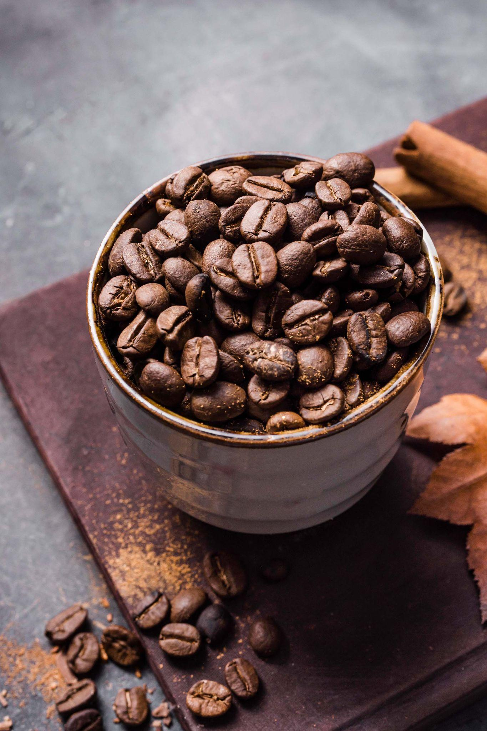
Recommendations
Source coffee from METAD & Almacafé :
High guaranteed of quality coffee for brewing
Colombia & Ethiopia are top producers, a top global coffee producer
Process coffee beans by washing
Prioritize flavor & aftertaste

Slide 29

THANKS
ANY QUESTIONS?

